Slide 1
MATH1003
肖其凯 Rainbow
University of Macau
15/4/2021
21/5/2021

Slide 2
MATH1003 Intermediate Calculus
Course Description
Definite integrals. Fundamental theorem of calculus. Applications of definite integrals. Approximations of definite integrals. Sequence and series. Power series and Taylor series.
Prerequisite
GEST1004
MATH2000 ECEN3001
Notes:
学习本质是最重要的

Slide 3

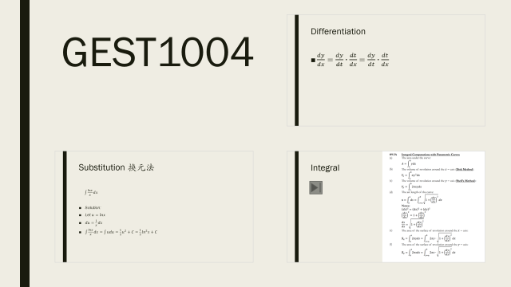
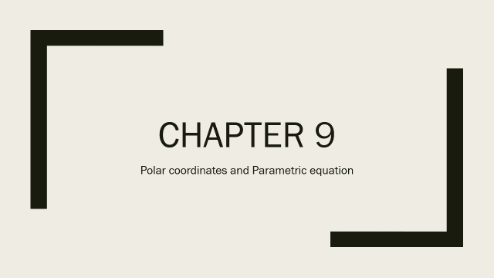



Chapters
Chapter 7: Techniques of Integration
Chapter 9: Polar Coordinates
Chapter 10: Infinite Series（Test, Taylor）
Chapter 11: Vectors, Curves and Surfaces in Space

Slide 4
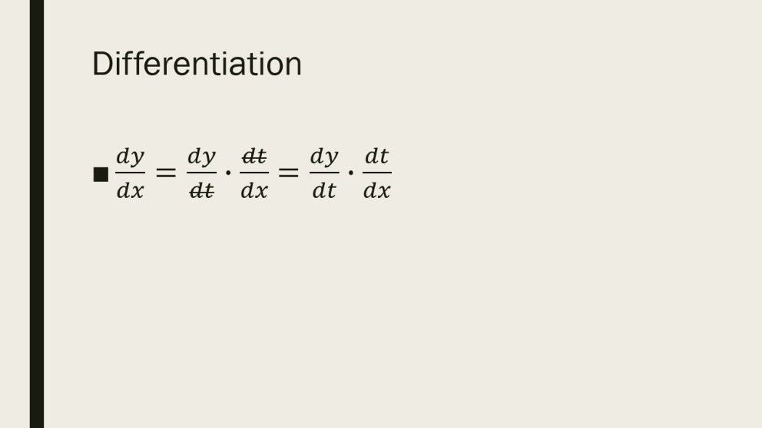
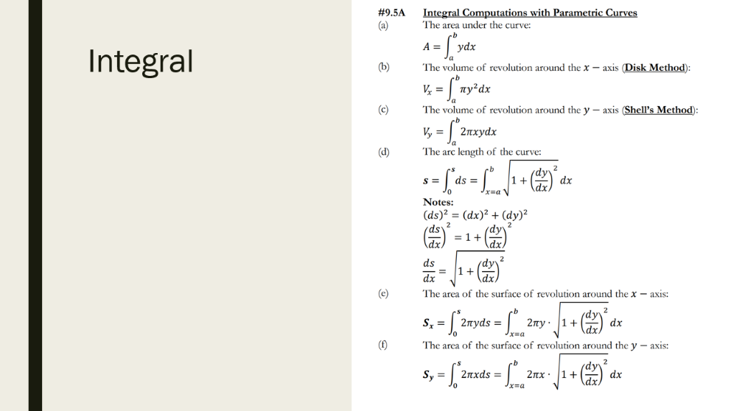
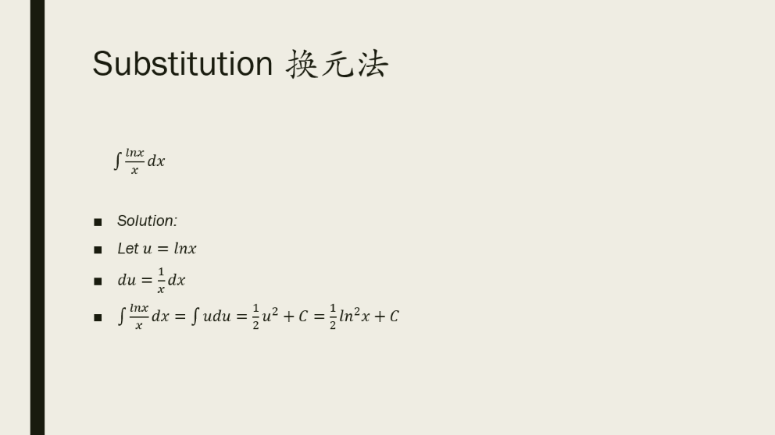
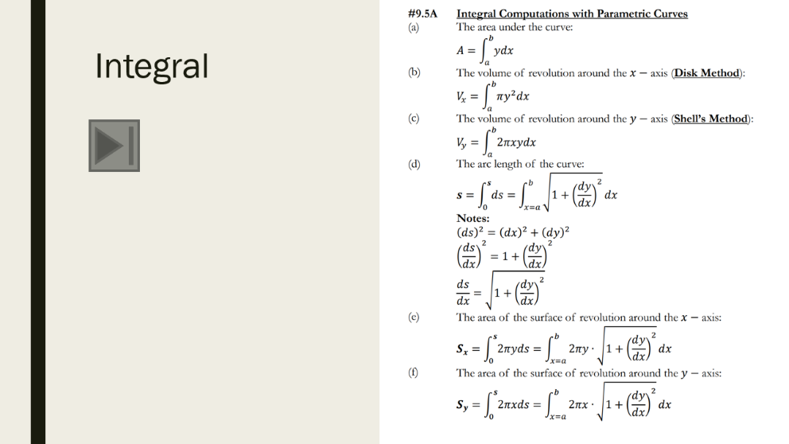
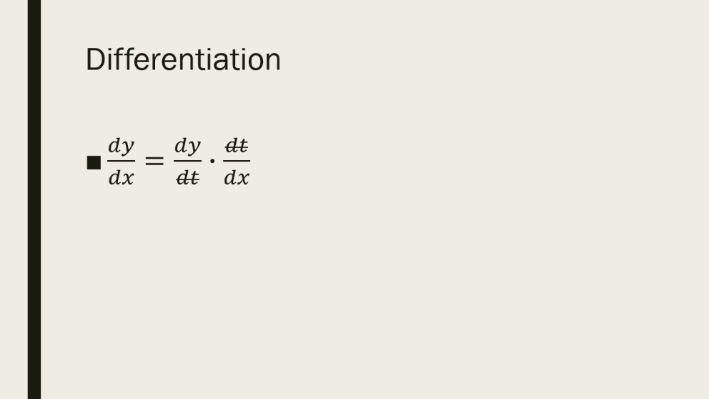

GEST1004

Slide 5

Substitution 换元法
$\int{\frac{lnx}{x}dx}$
Solution:
Let $u=lnx$
$du=\frac{1}{x}dx$
$\int{\frac{lnx}{x}dx}=\int{udu=\frac{1}{2}u^{2}+C=}$ $\frac{1}{2}\ln^{2}x+C$

Slide 6
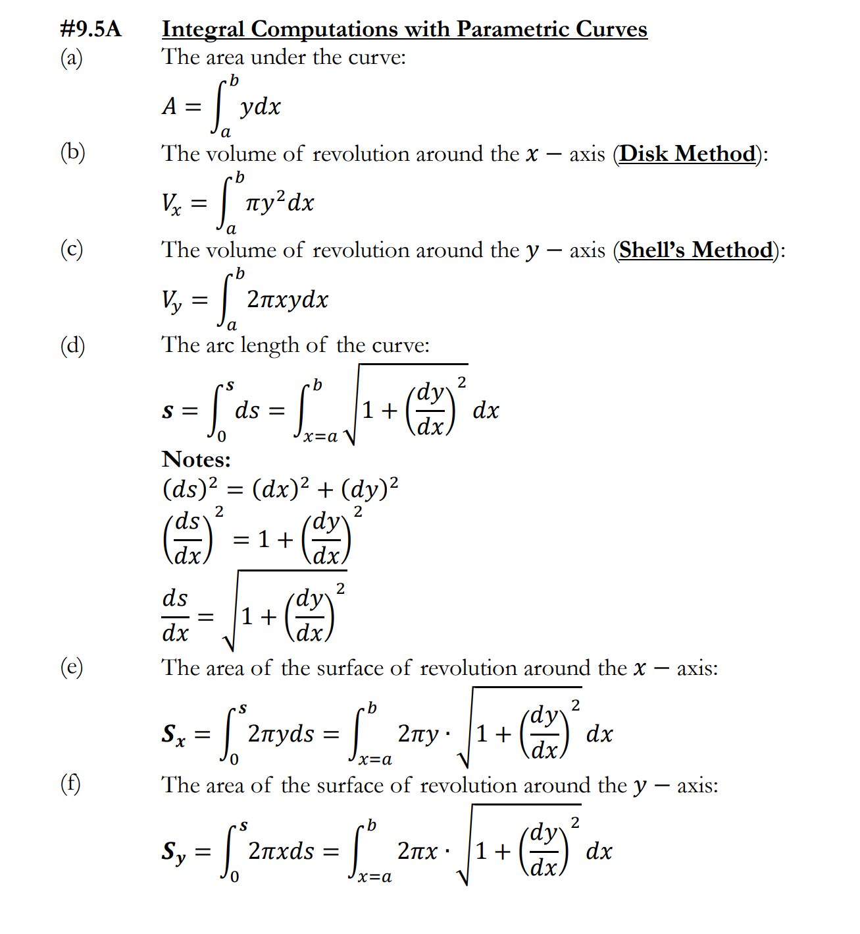
Integral

Slide 7

Differentiation
$\frac{dy}{dx}=\frac{dy}{dt}∙\frac{dt}{dx}$ $=\frac{dy}{dt}∙\frac{dt}{dx}$

Slide 8
Chapter 7
Techniques of Integration

Slide 9
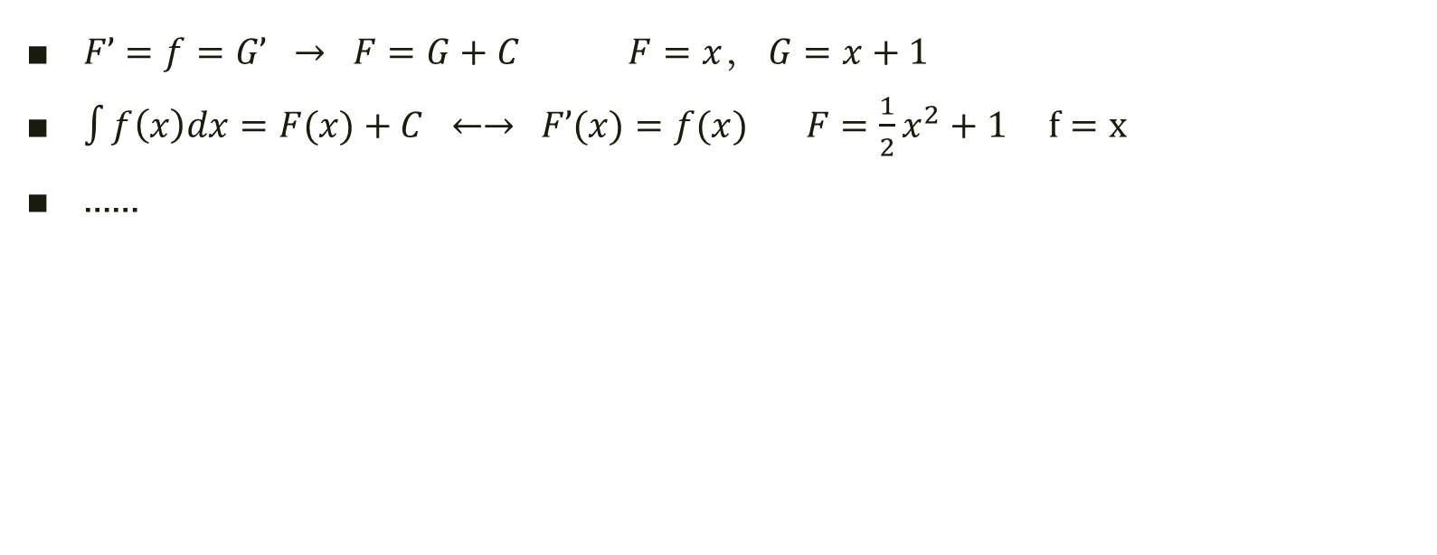
Some of Fundamental Theorems
$F’=f=G’ → F=G+C F=x， G=x+1$
$\int{f\left(x\right)dx}=F(x)+C ←→ F’(x)=f(x) F=\frac{1}{2}x^{2}+1 f=x$
……

Slide 10
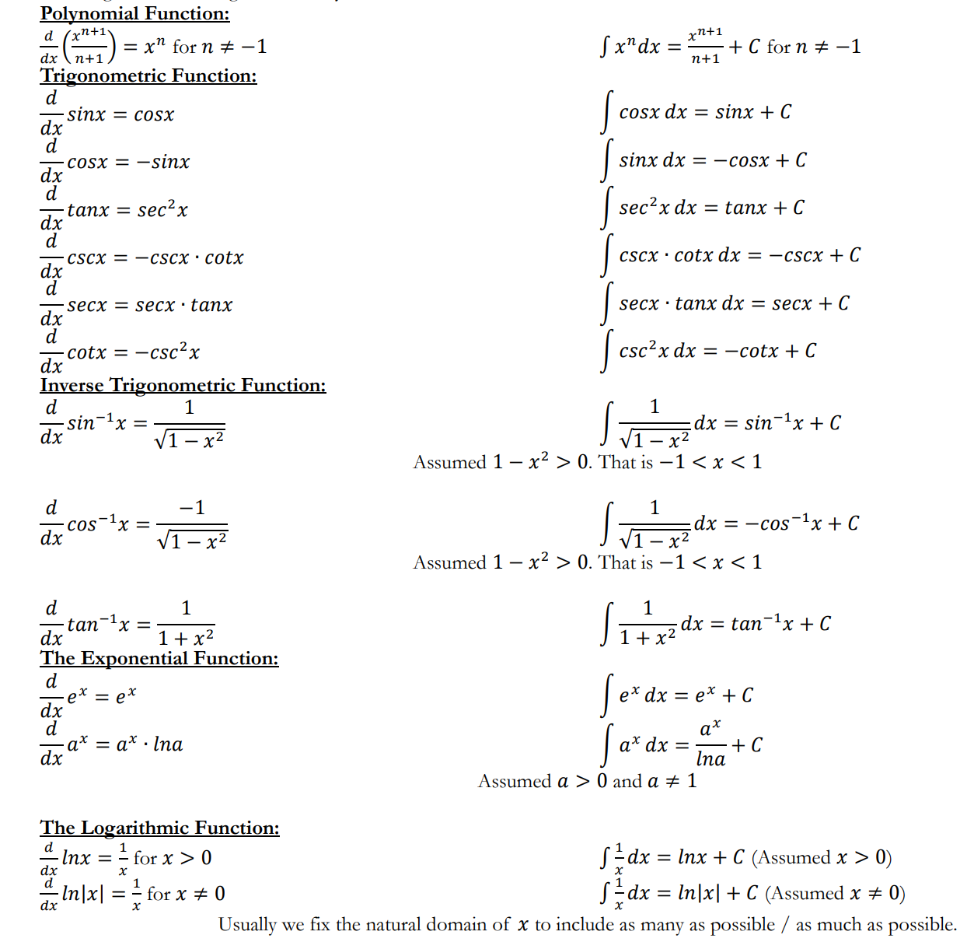



Indefinite Integrals of Common Integrands:
$$\sin^{2}x+\cos^{2}x=1$$
$$\cot^{2}x+1=\csc^{2}x$$
$$\tan^{2}x+1=\sec^{2}x$$

Slide 11
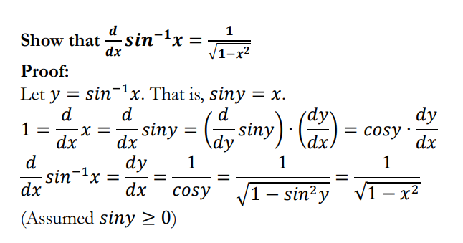

Slide 12
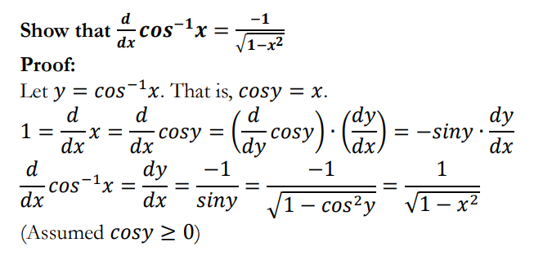

Slide 13
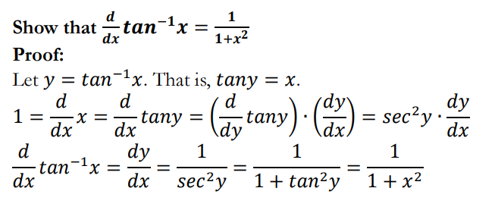

Slide 14
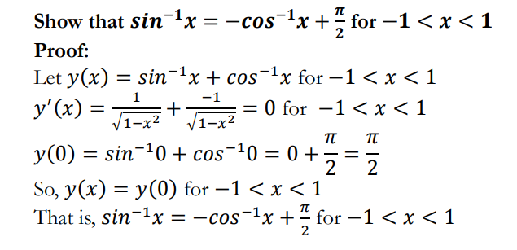

Slide 15

1.Simple Rule for Indefinite Integral:
Rule:
$\int{\left(a∙u\left(x\right)+b∙v(x)\right)}dx=$ $a∙\int{u\left(x\right)}dx+b∙\int{v(x)}dx$
Example:
$\int{2x+{3x}^{2}}dx=2\int{x}dx+3\int{x^{2}}dx$

Slide 16
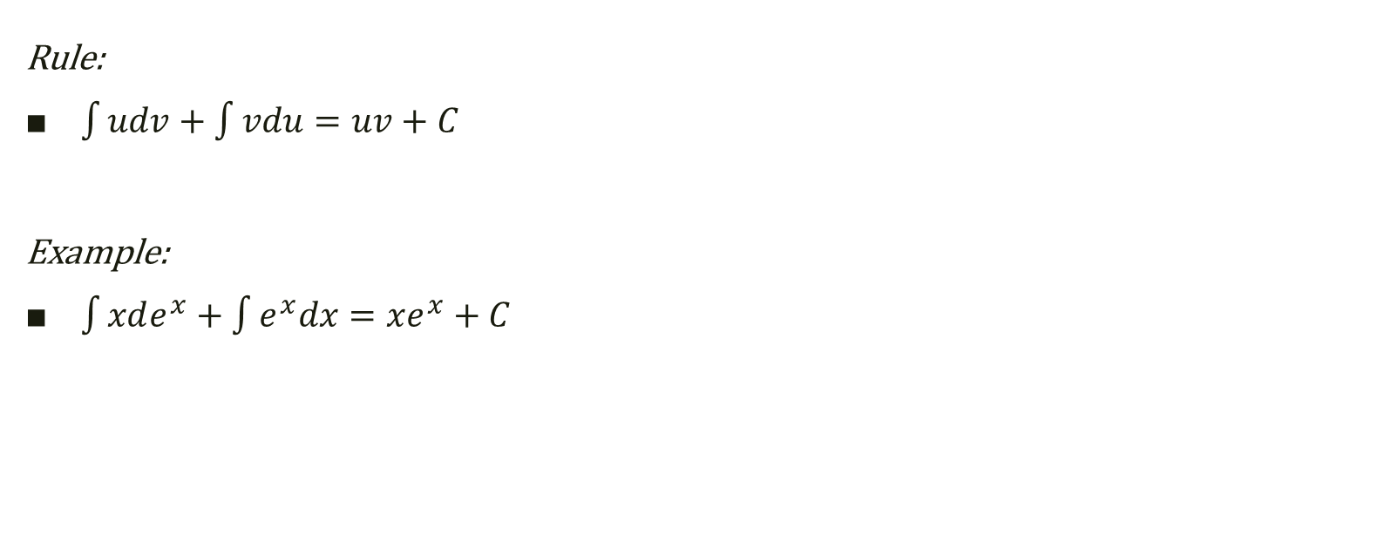
2. Integration by parts: 分部积分
Rule:
$\int{udv+\int{vdu}=uv+C}$
Example:
$\int{xde^{x}+\int{e^{x}dx}=xe^{x}+C}$

Slide 17
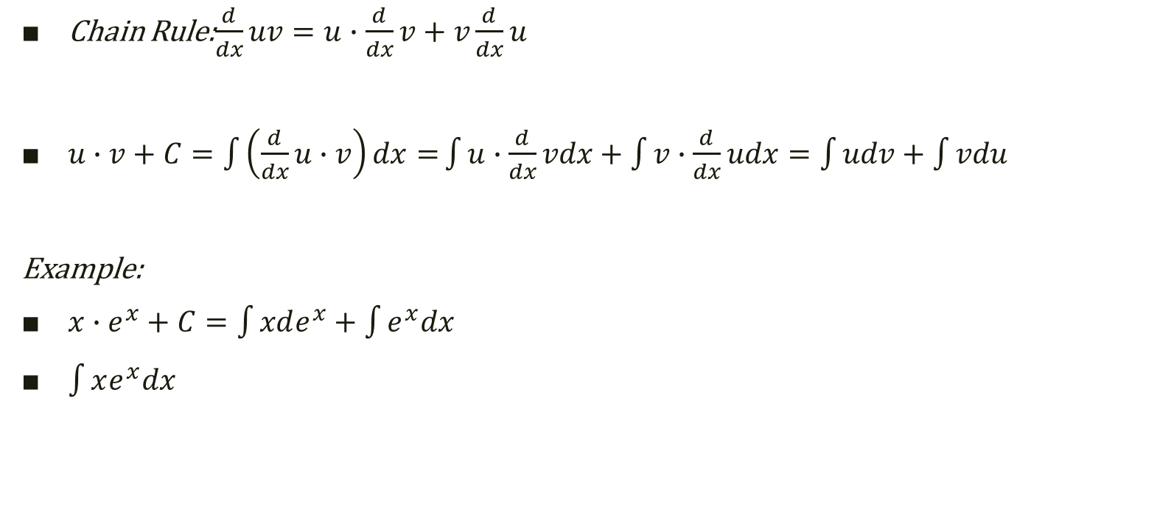
2. Integration by parts: (Proof)
Chain Rule:$\frac{d}{dx}uv=u∙$ $\frac{d}{dx}v+v\frac{d}{dx}u$
$u∙v+C=\int{\left(\frac{d}{dx}u∙v\right)dx=}\int{u∙\frac{d}{dx}vdx+\int{v∙\frac{d}{dx}udx}=\int{udv+\int{vdu}}}$
Example:
$x∙e^{x}+C=\int{xde^{x}}+\int{e^{x}dx}$
$\int{xe^{x}dx}$

Slide 18
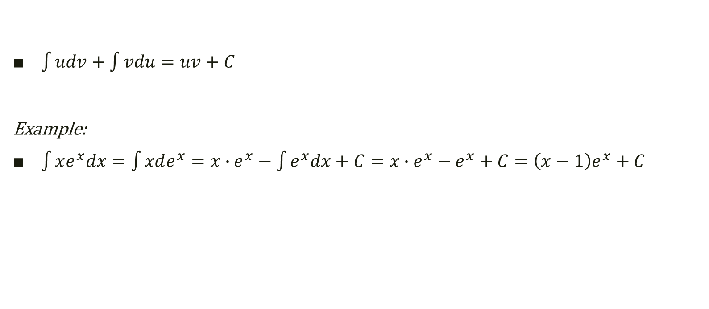
2. Integration by parts: ←反对幂指三←
$\int{udv+\int{vdu}=uv+C}$
Example:
$\int{xe^{x}dx}=\int{xde^{x}}=x∙e^{x}−\int{e^{x}dx+C=x∙e^{x}−e^{x}+C}=\left(x−1\right)e^{x}+C$

Slide 19
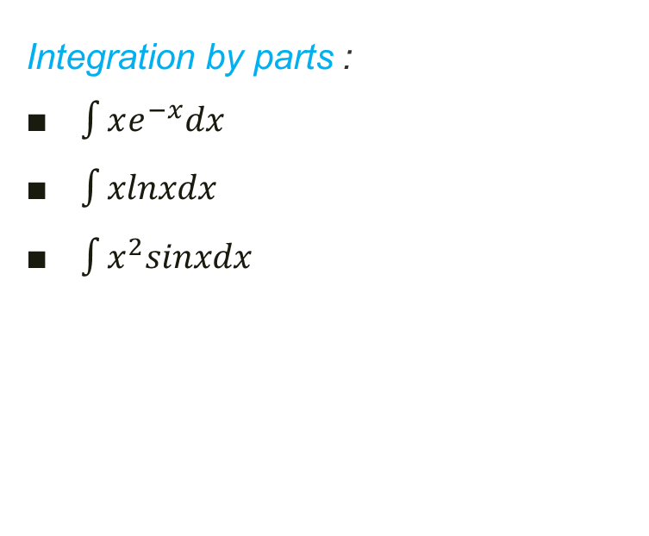

3.Substitution OR Integration by parts?
Substitution:
$\int{\frac{lnx}{x}dx}$
$\int{\frac{x}{1+x^{2}}dx}$
$\int{\frac{sinx}{\cos^{5}x}dx}$
Integration by parts :
$\int{xe^{−x}dx}$
$\int{xlnxdx}$
$\int{x^{2}sinxdx}$

Slide 20
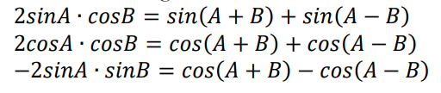
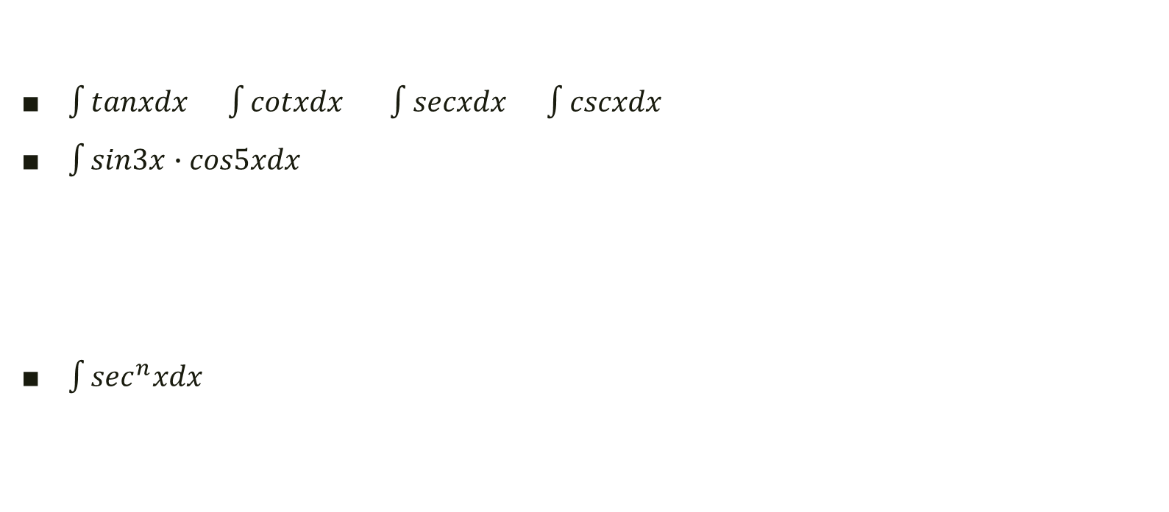
4.Trick I (trigonometric function)
$\int{tanxdx}$ $\int{cotxdx \int{secxdx \int{cscxdx}}}$
$\int{sin3x∙cos5xdx}$
$\int{\sec^{n}xdx}$

Slide 21

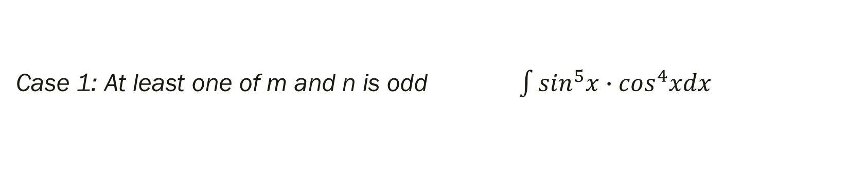

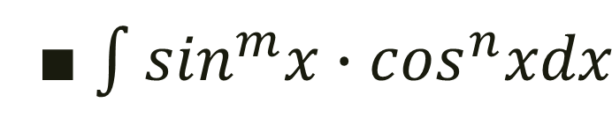

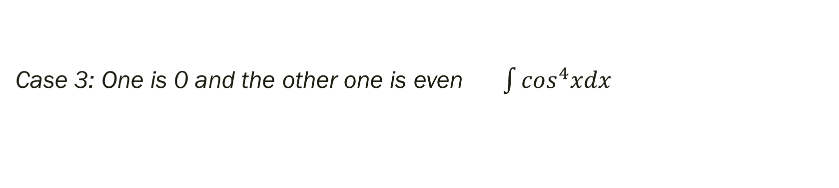
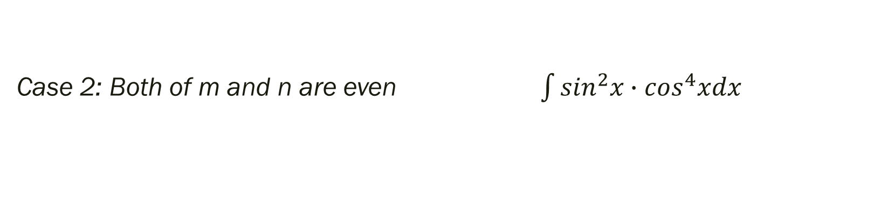
4.Trick II (trigonometric function)
$\int{\sin^{m}x∙\cos^{n}xdx}$
Case 1: At least one of m and n is odd $\int{\sin^{5}x∙\cos^{4}xdx}$
$$u=sinx/cosx$$
Case 2: Both of m and n are even $\int{\sin^{2}x∙\cos^{4}xdx}$
$$→cos2x$$
Case 3: One is 0 and the other one is even $\int{\cos^{4}xdx}$
$$→cos2x$$

Slide 22

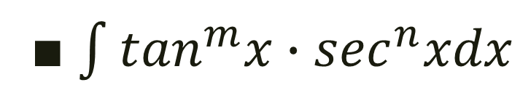

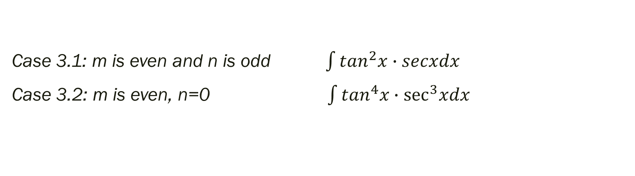

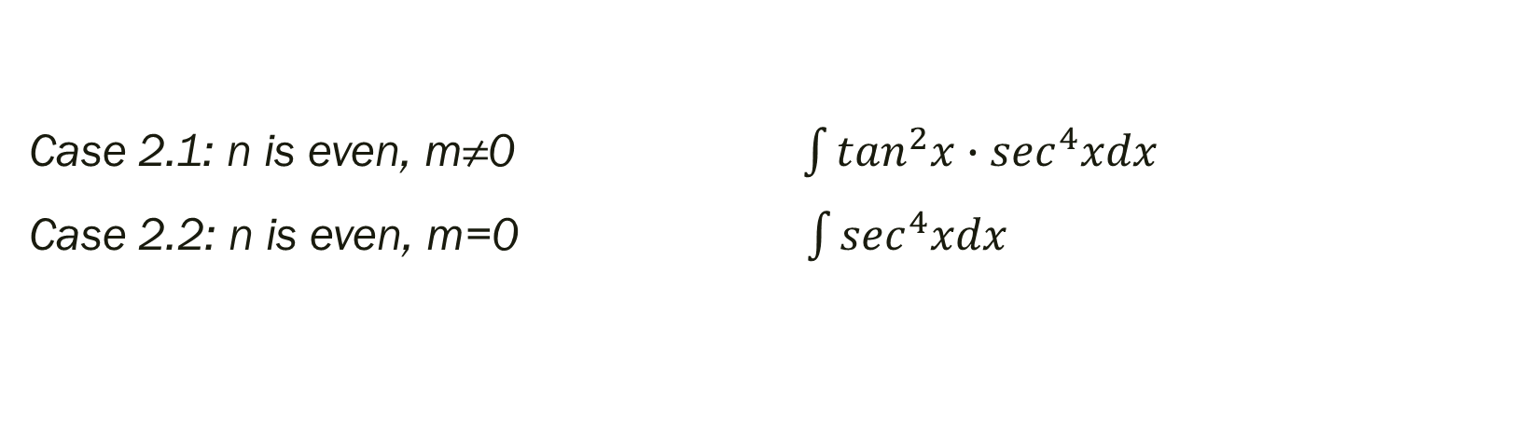
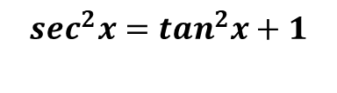
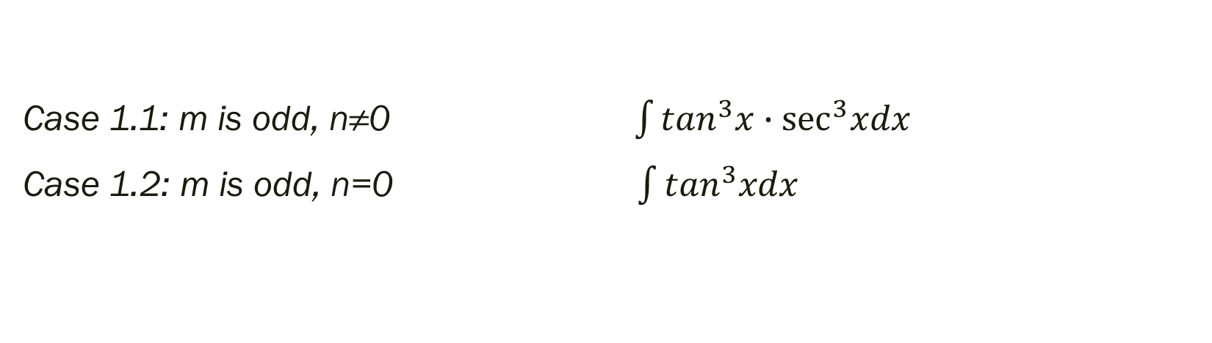

4.Trick III (trigonometric function)
$\int{\tan^{m}x∙\sec^{n}xdx}$
Case 1.1: m is odd, n≠0 $\int{\tan^{3}x∙\sec^{3}xdx}$
Case 1.2: m is odd, n=0 $\int{\tan^{3}xdx}$
$$u=secx$$
$$\tan^{2}x=\sec^{2}x−1$$
Case 2.1: n is even, m≠0$\int{\tan^{2}x∙\sec^{4}xdx}$
Case 2.2: n is even, m=0$\int{\sec^{4}xdx}$
$$u=tanx$$
$$\sec^{2}x=\tan^{2}x+1$$
Case 3.1: m is even and n is odd $\int{\tan^{2}x∙secxdx}$
Case 3.2: m is even, n=0 $\int{\tan^{4}x∙\sec^{3}xdx}$
$$\tan^{2}x=\sec^{2}x−1$$

Slide 23
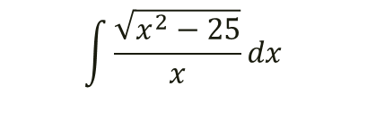
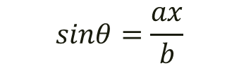
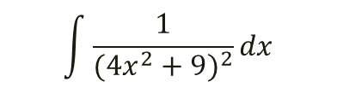


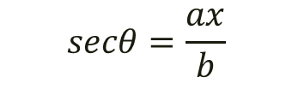
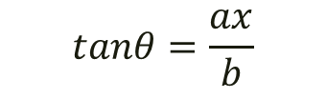
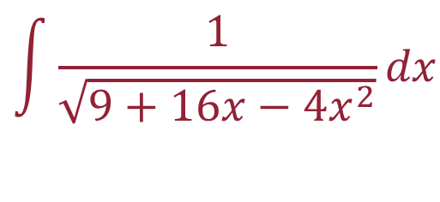
4.Trick IV (trigonometric function)
$$\int{\frac{1}{\sqrt{9+16x−4x^{2}}}dx}$$
${① a}^{2}−b^{2}x^{2}$
${② a}^{2}+b^{2}x^{2}$
③ $b^{2}x^{2}−a^{2}$
$$sinθ=\frac{ax}{b}$$
$$\int{\frac{x^{3}}{\sqrt{1−x^{2}}}dx}$$
$$tanθ=\frac{ax}{b}$$
$$\int{\frac{1}{{(4x^{2}+9)}^{2}}dx}$$
$$secθ=\frac{ax}{b}$$
$$\int{\frac{\sqrt{x^{2}−25}}{x}dx}$$

Slide 24
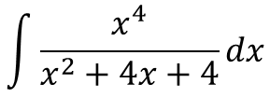
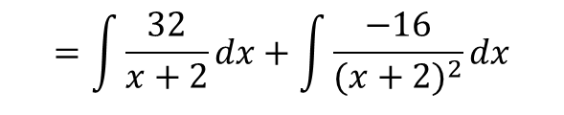
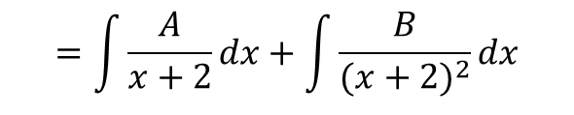
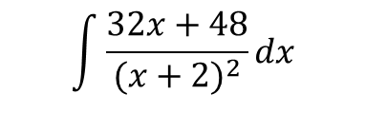
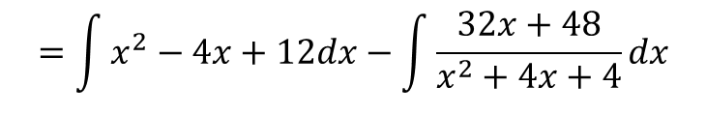
4.Trick V (fraction)
Improper fractions → Simple proper fractions → Partial fractions
$$\int{\frac{x^{4}}{x^{2}+4x+4}dx}$$
$$=\int{x^{2}−4x+12dx}−\int{\frac{32x+48}{x^{2}+4x+4}dx}$$
$$\int{\frac{32x+48}{{(x+2)}^{2}}dx}$$
$$=\int{\frac{A}{x+2}dx+\int{\frac{B}{{(x+2)}^{2}}dx}}$$
$$=\int{\frac{32}{x+2}dx+\int{\frac{−16}{{(x+2)}^{2}}dx}}$$

Slide 25

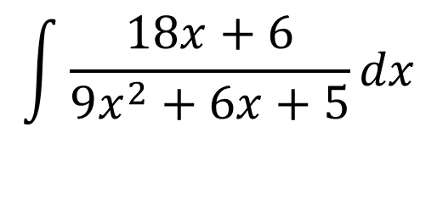
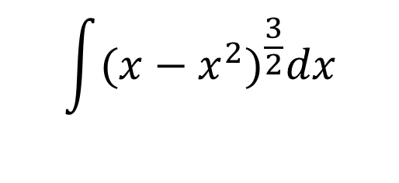



Exercise time!
$$\int{{(x−x^{2})}^{\frac{3}{2}}dx}$$
$$\int{\frac{x^{2}}{\sqrt{9−4x^{2}}}dx}$$
$$\int{\sin^{−1}xdx}$$
$$\int{e^{2x}∙sin3xdx}$$
$$\int{x^{3}\sqrt{1−x^{2}}dx}$$
$$\int{\frac{18x+6}{9x^{2}+6x+5}dx}$$

Slide 26

More exercise! 3+2+2+3

Slide 27

5. Improper integrals 反常积分 瑕积分
$\int_{a}^{b}{f\left(x\right)dx}$

Slide 28

5. Improper integrals 反常积分
Converge or Diverge?
收敛 发散
$\int_{−∞}^{0}{\frac{1}{\sqrt{1−x}}dx}$ converges or diverges? If converges, find the value.
Solution: For$M>0$
$$\int_{−M}^{0}{\frac{1}{\sqrt{1−x}}dx=−2{\left(1−x\right)}^{\frac{1}{2}}|_{x=−M}^{0}=−2{\left(1−{\left(1+M\right)}^{\frac{1}{2}}\right)}^{}→∞ as M→∞}$$
$$∴\int_{−∞}^{0}{\frac{1}{\sqrt{1−x}}dx} diverges$$
$$∴\int_{−∞}^{∞}{\left|x\right|e^{−x^{2}}dx} converges to 1$$

Slide 29

5. Improper integrals 反常积分
Converge or Diverge?
收敛 发散
$$\lim_{M→∞}{\int_{−M}^{M}{f(x)dx≠}}\int_{−∞}^{∞}{f\left(x\right)dx}$$
For example:
$\lim_{M→∞}{\int_{−M}^{M}{xdx}}$ Converges to 0
$\int_{∞}^{∞}{xdx }$ Diverges

Slide 30

6.Useless things…(at least for now)
Gamma function$Γ\left(t\right)=\int_{0}^{∞}{x^{t−1}{∙e}^{−x}dx}$ $Γ\left(n\right) converges to (n−1)!$
Beta function $B\left(x,y\right)=\int_{0}^{1}{t^{x−1}∙{\left(1−t\right)}^{y−1}dt for x,y>0}$
Escape velocity
$$W_{r}=\int_{R}^{r}{\frac{GMm}{x^{2}}dx→\frac{GMm}{R} as r→∞}$$
$$\frac{1}{2}mv^{2}=\frac{GMm}{R}$$
$$v=\sqrt{\frac{2GM}{R}}$$

Slide 31
Chapter 9
Polar coordinates and Parametric equation

Slide 32

1.Polar coordinates
$ρ=f\left(θ\right)$ $(ρ,θ)$
极径$ρ ∈R \text{偏转角}θ∈\left[0,2π\right]$
$\left(1,\frac{π}{3}\right)=(−1,\frac{4π}{3})$
$\left\{\begin{aligned}x=ρcosθ \\ y=ρsinθ\end{aligned}\right.$ $ρ^{2}=x^{2}+y^{2}$
For example:
$$ρ=1$$
$$ρ=4cosθ$$

Slide 33

2.Area of Polar coordinates
Area of sector:
$$A=πr^{2}∙\frac{θ}{2π}=\frac{1}{2}{θ∙r}^{2}$$
Area of polar coordinates graph:
$$A=\frac{1}{2}\int_{θ_{2}}^{θ_{1}}{ρ^{2}dθ}$$

Slide 34


3.Parametric equation
$\left\{\begin{aligned}x=\frac{1−t^{2}}{1+t^{2}} \\ y=\frac{2t}{1+t^{2}}\end{aligned}\right.$ $(t=tan\frac{θ}{2}→x^{2}=\cos^{2}θ,y^{2}=\sin^{2}θ)$
$\left\{\begin{aligned}x=tcosa \\ y=tsina\end{aligned}\right. (t is parameter) y=x∙tana$
$\left\{\begin{aligned}x=t^{2}∙\sqrt{3} \\ y=3t−\frac{1}{3}t^{3}\end{aligned}\right.$ Find the area of the region rounded by the part of the cure for which $−3≤t≤3$
……

Slide 35


Find the area inside the circle $r=2sinθ$and outside the circle $r=1$
Given the curve $x=t^{2}$, $y=t^{3}−3t for t∈R. Find:$
(a) the points on the curve where the tangent line is horizontal
(b) the slope of each tangent line at any point where the curve intersects the x- axis

Slide 36


Slide 37


Slide 38
Chapter 10
Infinite Series

Slide 39

1.Fundamental theorems
1. if $\lim_{n→∞}{a_{n}=L}$ then $\lim_{n→∞}{a_{n+k}=L}$ (k is a real number)
2. if$\lim_{n→∞}{a_{2n}=L, }\lim_{n→∞}{a_{2n−1}=L}$ then $\lim_{n→∞}{a_{n}=L}$
3. if $\lim_{n→∞}{a_{n}=A,\lim_{n→∞}{b_{n}=B}}, c_{n}=a_{n}?b_{n}$, ${\lim_{n→∞}{c_{n}=}}A?B$
Squeeze rule
$a_{n}=f\left(n\right), \lim_{n→∞}{f(n)}=$ $\lim_{x→∞}{f(x)}$ (x is a real number) [it is for L’Hopital’s Rule]
For $−1<r<1,\lim_{n→∞}{r^{n}=0}$

Slide 40
2.Monotonic theorem
Monotonic Increasing Sequence that is Bounded Above converges
Monotonic Decreasing Sequence that is Bounded Below converges

Slide 41

3.Nested Radicals and Continued Fractions
$\sqrt{q+p\sqrt{q+\sqrt{…}}}=p+\frac{q}{p+\frac{q}{…}} a_{n+1}=$ $\sqrt{q+pa_{n}}, { a}_{n+1}=$ $p+\frac{q}{a_{n}}$
Proof

Slide 42

4.Sum sequence
$S_{n}=\sum_{k=1}^{n}{a_{k}}$
${\{S}_{n}\}$ is called sum sequence/series
Sometimes we write the series as $\sum_{n=1}^{∞}{a_{n} or}\sum{a_{n}}$

Slide 43

5.The geometric series (几何级数/等比数列)
$a_{n}=a_{0}∙r^{\left(n−1\right)}$
$S_{n}=\sum{a_{n}}=\frac{a ∙ (1−r^{n})}{1−r}$
Theorem:
If $\left|r\right|<1, \sum_{n=1}^{∞}{a_{n }converges} to \frac{a }{1−r}$
If $\left|r\right|>1, \sum_{n=1}^{∞}{a_{n }diverges}$
Exercise:
Rewrite $0.287\ddot{56}$ as a geometric series

Slide 44

6.Nth term test for diverges 第n项审敛法/常数项级数审敛法
If $\lim_{n→∞}{a_{n}≠0 or }$ $\lim_{n→∞}{a_{n}}$ doesn’t exist as a real number, then $\sum_{n=1}^{∞}{a_{n}}$ diverges.
Remark:
$\sum_{n=1}^{∞}{a_{n}}$ converges $\lim_{n→∞}{a_{n}}=0$

Slide 45


7.Harmonic series
$$\sum_{n=1}^{∞}{\frac{1}{n^{p}} for p>0 is called p−series}$$
$\sum_{n=1}^{∞}{\frac{1}{n}}$
Converges or diverges?
Can we apply nth term test on it?
Diverge
if p>1, ∑1np converges and if p<=1 it diverges for p∈R+

Slide 46

8.Important Theorem about the Convergence or Divergence of Series
Suppose k is a positive integer.
$${\{a}_{n}\} and \left\{b_{n}\right\} are sequences of real number AND$$
$a_{n}=b_{n}$ for $n≥k$
Then,
$\sum_{n=1}^{∞}{a_{n}}$ converges $\overset{⇔}{}\sum_{n=1}^{∞}{b_{n}}$ converges
$\sum_{n=1}^{∞}{a_{n}}$ diverges $\overset{⇔}{}\sum_{n=1}^{∞}{b_{n}}$ diverges
Conclusion:
We only care the “tail” of the series.

Slide 47

9.Integral Test for positive-term series 积分审敛法
Suppose $a_{n}=f\left(n\right)>0for n=1,2,3,…$
The series ${\sum_{n=1}^{∞}{a}}_{n}=converges\overset{⇔}{}\int_{1}^{∞}{f\left(t\right)dt converges}$
The series ${\sum_{n=1}^{∞}{a}}_{n}=diverges\overset{⇔}{}\int_{1}^{∞}{f\left(t\right)dt diverges}$
Integral Test Remainder Estimate

Slide 48

9.Integral Test for positive-term series 积分审敛法
Suppose that $f:R→R$is a function such that:
1. $f\left(t\right)>0 for any t≥1 AND$
2. $f$ is continuous on$[1,∞) AND$
3. $f$ is strictly decreasing on $[1,∞)$
That is, for any $α,β∈[1,∞)$ with $α<β, we must have f\left(α\right)>f\left(β\right)$
Then the series
$\sum_{n=1}^{∞}{f\left(n\right)converges\underset{⇔}{} the improper integral \int_{1}^{∞}{f\left(t\right)dt converges.}}$

Slide 49

10. Comparison Test for Positive-Term Series 比较审敛法
Suppose $\sum_{n=1}^{∞}{a_{n}} and\sum_{n=1}^{∞}{b_{n} are positive−term series}$, $a_{n}≤$ $b_{n}$
Then, $b_{n} converges\underset{⇒}{}a_{n} converges;$
$a_{n} diverges\underset{⇒}{}b_{n} diverges$

Slide 50

11. Limit Comparison Test for Positive-Term Series
Suppose $\sum_{n=1}^{∞}{a_{n}}$ and $\sum_{n=1}^{∞}{b_{n}}$ are positive-term series, $\lim_{n→∞}{\frac{a_{n}}{b_{n}}=L}$
Case1: L is a positive real number:
$\sum_{n=1}^{∞}{a_{n}} converges\underset{⇔}{}$ $\sum_{n=1}^{∞}{b_{n} converge}$, $\sum_{n=1}^{∞}{a_{n}} diverges\underset{⇔}{}$ $\sum_{n=1}^{∞}{b_{n} diverge}$
Case2: L=0:
$\sum_{n=1}^{∞}{a_{n}} diverges\underset{⇒}{}$ $\sum_{n=1}^{∞}{b_{n} diverge}$
Case3: L=$+∞$：
$\sum_{n=1}^{∞}{b_{n}} diverges\underset{⇒}{}$ $\sum_{n=1}^{∞}{a_{n} diverge}$

Slide 51
12. Rearrangement and Grouping
…

Slide 52

13.Alternating Series
$\sum_{n=1}^{∞}{a_{n}}$
$b_{n}={(−1)}^{n+1}a_{n}$
$c_{n}={(−1)}^{n}a_{n}$

Slide 53

14.Ratio Test & Root Test
$\left\{a_{n}\right\}$
$ρ=\lim_{n→∞}\left|\frac{a_{n+1}}{a_{n}}\right| ρ=\lim_{n→∞}{\sqrt[n]{\left|a_{n}\right|}}$
Case 1: $0≤ρ<1$, $\sum_{n=1}^{∞}{a_{n}} converges absolutely$
Case 2: $ρ>1$, $\sum_{n=1}^{∞}{a_{n}} diverges$
Case 3: $ρ=1$, no conclusion

Slide 54

15.Power series
$u_{n}\left(x\right)=$ $a_{n}{ x}^{n} (u_{0}\left(x\right)=$ $a_{0})$
$a_{0}+\sum_{n=1}^{∞}{a_{n}}x^{n}$ $\sum_{n=0}^{∞}{a_{n}}x^{n}(x≠0)$
$a_{0}+\sum_{n=1}^{∞}{a_{n}}{(x−x_{0}^{})}^{n}$
Convergence radius
Convergence interval

Slide 55


15.Power series
$u_{n}\left(x\right)=$ $a_{n}{ x}^{n}$
Convergence radius
Convergence interval

Slide 56

16. Taylor Series
$f\left(a\right)+\sum_{n=1}^{∞}{\frac{f^{\left(n\right)}(a)}{n!}}{(x−a)}^{n}$
Why Taylor?

Slide 57

16. Taylor Series

Slide 58

16. Taylor Series

Slide 59

16. Taylor Series

Slide 60

16. Taylor Series

Slide 61

16. Taylor Series

Slide 62


16. Taylor Series
$f\left(a\right)+\sum_{n=1}^{∞}{\frac{f^{\left(n\right)}(a)}{n!}}{(x−a)}^{n}$
Taylor Polynomial
Nth degree Taylor Polynomial
Maclaurin Series
Binomial Series ${(x+1)}^{k},\text{Maclaurin} \text{Series}$

Slide 63


Slide 64
Test
Nth Term Test for diverge
Comparison Test for Positive-Term series
Limit Comparison Test for Positive-Term series
Alternating Series Test
Integral Test
Ratio Test
Root Test

Slide 65
Chapter 11
Vector Curves and Surfaces in Spaces

Slide 66

1.Cross product
$\vec{u}=(1,0,0)$; $\vec{v}=(0,1,0)$
$\left|\vec{u}×\vec{v}\right|=\left|\vec{u}\right|∙\left|\vec{v}\right|∙sinθ$
How about direction?
$\vec{u}×\vec{v}$ ? $\vec{v}×\vec{u}$

Slide 67

2. Matrix
$\left|\begin{matrix}a & b \\ c & d\end{matrix}\right|=a∙d−c∙b$
$\left|\begin{matrix}a1 & a2 & a3 \\ b1 & b2 & b3 \\ c1 & c2 & c3\end{matrix}\right|$
$=a1\left|\begin{matrix}b2 & b3 \\ c2 & c3\end{matrix}\right|−…+…$
$=a1·b2·c3+b1·c2·a3+c1·a2·b3−a3·b2·c1−b3·c2·a1−c3·a2·b1$
$\vec{u}=(1,2,3)$; $\vec{v}=\left(4,5,6\right)$
$\vec{u}×\vec{v}？$

Slide 68

3. Equation of line

Slide 69

4. Equation of plane

Slide 70
Q&A
考试加油嗷

